Slide 1
Pets shop management system…
NAME : Sarthak Santosh Shinde &
Aman Harun Shaikh
SEAT NO : 156 & 158

Slide 2
INTRODUCTION
This proposed Online Pet Shop Management System in PHP was designed to manage the pet information such to produce the pet breed and the vaccine schedules. It is also performed in systematic through its function requirement.
The management of pet shop includes the services offers such as cleaning, scissoring, bathing and blow-drying.
First, the pet must be registered before having any services. Any piece of information about the pets must be correct and organized to avoid any problem to be in countered like the bad feedback from the customer.
The purpose of this system is to transact and deals with a nice and easier way by simply gathering information from the customer. It also helps to every individual by searching for the information needed.

Slide 3
EXISTING SYSTEM AND LIMITATIONS OF THE EXISTING SYSTEM
1.Limited Geographical Reach: The physical store restricts the reach of the pets shop to the local area, limiting the customer base and potential sales.
2.Manual pets Management: Pets management is often done manually, leading to inaccuracies, stockouts, and difficulties in tracking product availability.
3.Limited Product Visibility: Customers can only view and purchase products available in the physical store, reducing their choices and potentially missing out on popular or specialized items.
4.Inefficient Order Processing: Order processing is often time-consuming and prone to errors since it involves manual entry, tracking, and fulfillment.
5.Lack of Integrated Payment System: The existing system may not have a secure and integrated payment gateway, requiring customers to make payments through offline methods, which can be inconvenient and less secure.
6.Limited Customer Interaction: Customer interactions are primarily face-to-face or through traditional communication channels, making it challenging to provide timely assistance or personalized services.
7.Lack of Sales Monitoring and Analytics: There is a lack of systematic sales monitoring and analysis, which hinders the ability to track performance, identify trends, and make data-driven business decisions

Slide 4
NEED FOR THE PROPOSED SYSTEM
1.Expanded Customer Reach: The proposed system will provide an online platform that extends the reach of the pets shop beyond its physical location. It allows customers from anywhere to browse and purchase pets and pet-related products, leading to an expanded customer base and increased sales potential.
2.Enhanced Convenience: The proposed system offers customers the convenience of browsing and shopping for pets and pet-related products from the comfort of their own homes. It eliminates the need for them to visit the physical store, saving time and effort.
3.Automated Inventory Management: The proposed system automates inventory management processes, ensuring real-time updates on product availability. This reduces stockouts, eliminates manual errors, and improves overall inventory accuracy.
4.Streamlined Order Processing: The proposed system streamlines the order processing and fulfillment process. Customers can easily place orders, choose delivery options, and track the status of their purchases. This improves efficiency, reduces errors, and enhances customer satisfaction.
5.Secure Online Transactions: The proposed system integrates a secure payment gateway, enabling customers to make online transactions with confidence. It protects their payment information and ensures secure and seamless payment processing.
6.Personalized Customer Experience: The proposed system allows for personalized customer experiences. Customers can create accounts, save their preferences, and receive personalized recommendations based on their previous purchases and browsing history.

Slide 5
PROPOSED SYSTEM
OBJECTIVES OF PROPOSED SYSTEM
Online Catalog: The system should allow pet shop owners to create and manage an online catalog of available pets, including their details, images, breed, age, price, and any additional information.
Customer Registration and Login: Customers should be able to register and create an account on the website. They can log in using their credentials to access various features like searching for pets, placing orders, and managing their profile.
Search and Filtering: The system should provide a search functionality that enables customers to search for pets based on specific criteria such as breed, age, gender, or price range. Additionally, filtering options should be available to refine the search results.
Pet Details and Availability: Customers should be able to view detailed information about each pet, including its description, health records, vaccination history, and availability status.
Online Booking and Adoption: Customers should have the option to book or adopt a pet online. They can select a pet, provide their contact information, and specify any additional requirements or preferences..
Pets Management: The system should enable pet shop owners to manage their Pets effectively. It should provide features to track the availability of pets, update stock quantities, and automatically adjust inventory after successful adoptions or purchases.
Order Management: The system should allow pet shop owners to manage customer orders efficiently. They should be able to view and process orders, update their status (e.g., pending, in progress, delivered), and generate invoices or receipts.

Slide 6
FUNCTIONAL REQUIREMENTS
Implementation is the stages of project when the theoretical design is turned into a working system. If the implementation stage is not properly planned and controlled, it can cause chaos. Thus it can be consider to be most crucial stage in achieving successful new system and in giving the users confidence that the new system will work and be effective. Normally this stage involves setting up a co-ordination committee, which will act as a sounding board of ideas, complaints and problems. The first task is implementation planning ie; of the methods and time scale to be adopted. Apart from planning, the two major task of repairing for implementation are education and training of administrator and testing of the system. After the implementation phase is completed and the user staff adjusted to the changes created by the candidate system, evaluation and maintenance is continue to bring the new system standards. The activities of the implementation phase can be summarized as:
Implementation planning.
Eduction and training
System training

Slide 7
NON-FUNCTIONAL REQUIREMENTS
Performance requirements:The response time should not vary with the increasing the size of the data storage.
Security requirements: This application should not modify any vacci- nation details because the modules are authenticated.The username and password should be a unique token id.
Training requirements: Training has to be provided by the supervisor.
Validation and verification:Checks all the fields are filled and valid.The password is invisible by applying dots

Slide 8
SCOPE OF THE SYSTEM
Pet Management: The system will allow pet shop owners to manage their Pets of pets, including adding new pets, updating pet details, tracking availability, and removing sold or adopted pets from the inventory.
Customer Management: The system will facilitate customer registration, login, and profile management. It will also enable pet shop owners to maintain customer records, track their orders, and communicate with them.
Online Catalog and Search: The system will provide an online catalog of pets, allowing customers to browse and search for pets based on various criteria such as breed, age, gender, or price range. It will display detailed information about each pet, including descriptions and images.
Booking and Adoption: Customers will have the ability to book or adopt pets online through the system. They can select a pet, provide their contact information, and specify any preferences or requirements. The system will facilitate the booking or adoption process and update the inventory accordingly.
Order Management: The system will allow pet shop owners to manage customer orders. They can view and process orders, update order statuses, generate invoices or receipts, and track the progress of each order.
Administrative Backend: The system will include an administrative backend that allows the pet shop owner to manage system settings, user accounts, and access various reports and analytics. This backend will provide administrative control over the system's functionalities and configurations.

Slide 9
MODULE SPECIFICATION
User Management Module:
User Registration: Allows customers to register and create an account.
User Login: Enables customers and administrators to log into the system.
Profile Management: Allows users to update their profile information.
Pet Inventory Management Module:
Add Pet: Enables pet shop owners to add new pets to the inventory.
Update Pet Details: Allows pet shop owners to update pet information such as breed, age, price, and availability.
Remove Pet: Enables pet shop owners to remove pets from the inventory when they are sold or adopted
Catalog and Search Module:
Pet Listing: Displays a catalog of available pets, including their details and images.
Search Functionality: Allows customers to search for pets based on various criteria such as breed, age, gender, or price range.
Filtering Options: Provides filtering options to refine search results.
Booking and Adoption Module:
Pet Booking: Enables customers to book a pet by providing their contact information and specifying preferences.
Adoption Process: Facilitates the adoption process by guiding customers through the required steps.
Availability Update: Updates the pet's availability status after a booking or adoption is completed.

Slide 10
OPERATING ENVIRONMENT
Hardware Requirements:
Server: A web server is required to host the PHP-based system. It can be a physical server or a cloud-based server.
Storage: Sufficient storage capacity is needed to store the system files, pet images, customer data, and other related information.
Networking: A stable internet connection is necessary for the system to be accessible to users.
Software Requirements:
Operating System: The server should have a compatible operating system such as Linux, Windows, or macOS.
Web Server: Apache, Nginx, or Microsoft IIS can be used as the web server software.
PHP: The system should be developed using PHP programming language, so PHP runtime environment needs to be installed.
Database Management System: A database management system like MySQL, PostgreSQL, or SQLite is required to store and retrieve data.
Browser Compatibility: The system should be compatible with popular web browsers such as Chrome, Firefox, Safari, and Edge.

Slide 11
REQUIREMENT DETERMINATION AND ANALYSIS
FACT FINDING METHODS
Identify Stakeholders: Determine the key stakeholders involved in the project, such as pet shop owners, customers, employees, and administrators.
Conduct Interviews: Schedule interviews with the stakeholders to gather their requirements, expectations, and pain points related to the online pet shop management system. Prepare a set of questions to cover different aspects of the system, including inventory management, customer management, payment processing, order tracking, and reporting.
Questionnaires: Create online questionnaires or surveys to collect additional information from stakeholders who may not be available for interviews. This method can help gather feedback and insights from a larger audience.

Slide 12
FEASIBILITY STUDY
Project Description: Provide a clear and concise overview of the project, including its objectives, scope, and expected outcomes.
Market Analysis: Assess the target market for the project and analyze factors such as market size, trends, competition, and customer demand. Determine if there is a viable market for the product or service being offered.
Technical Feasibility: Evaluate the technical requirements of the project, including the technology, infrastructure, and resources needed to implement and maintain the system. Consider any potential challenges or limitations that may arise.
Financial Feasibility: Conduct a thorough financial analysis, including cost estimation, revenue projections, and return on investment (ROI) calculations. Assess the financial viability and profitability of the project.
Operational Feasibility: Evaluate the project's operational requirements, including staffing needs, workflow processes, and potential impacts on existing operations. Determine if the project can be integrated smoothly into the current operations or if any significant adjustments are required.

Slide 13
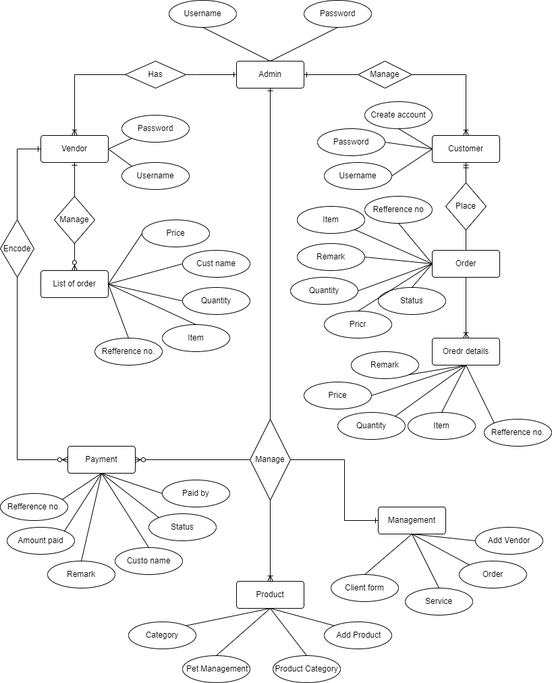
SYSTEM ANALYSIS AND DESIGN ENTITY RELATIONSHIP DIAGRAM

Slide 14
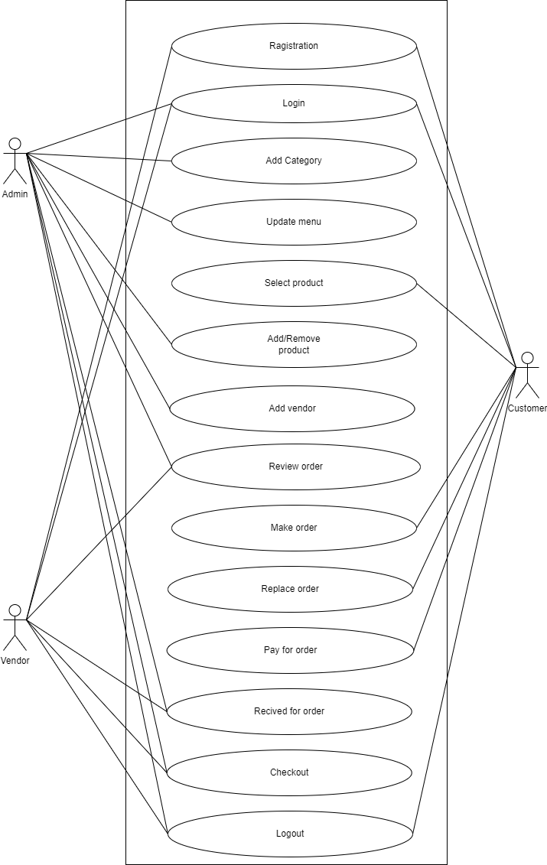
USE CASE DIAGRAM

Slide 15
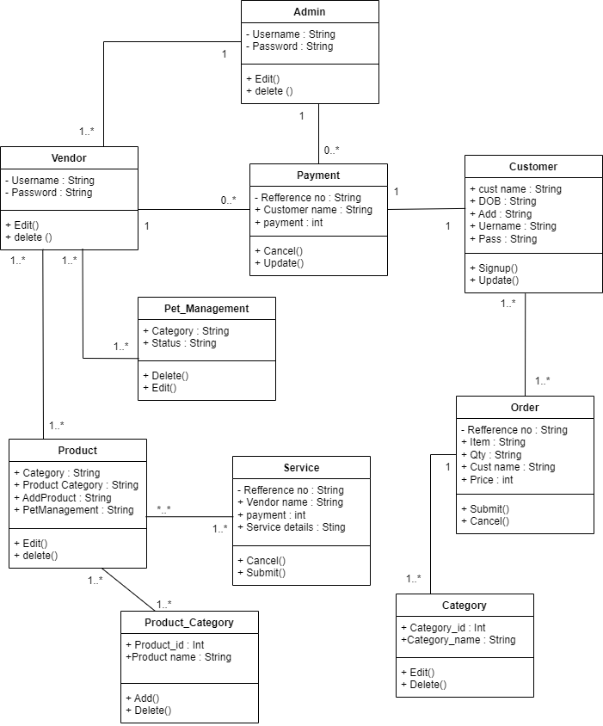
CLASS DIAGRAM

Slide 16
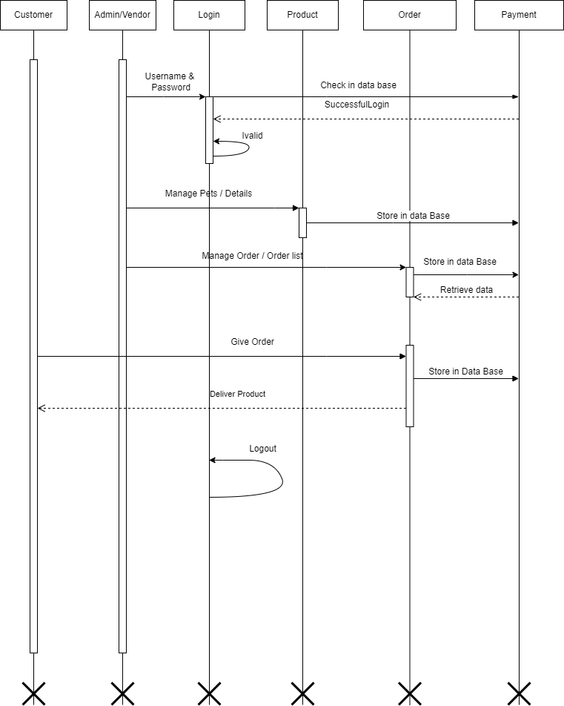
SEQUENCE DIAGRAM

Slide 17
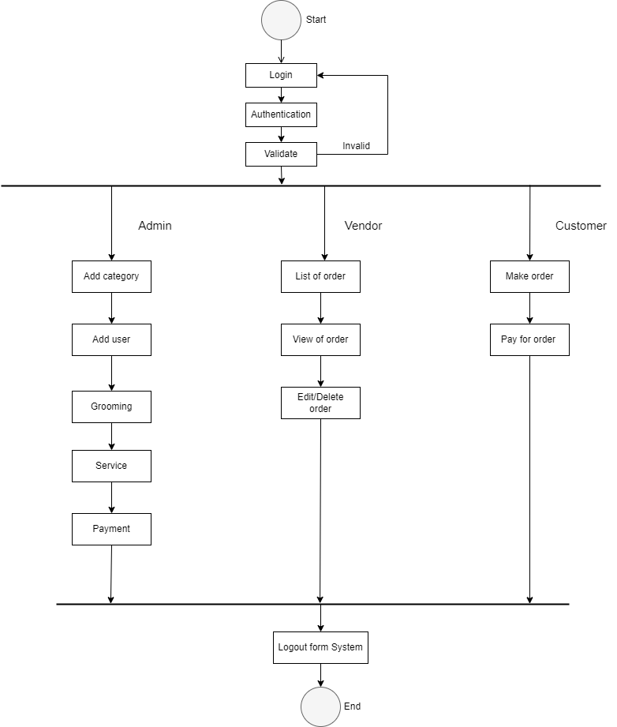
ACTIVITY DIAGRAM

Slide 18
DRAWBACKS AND LIMITAION
Assumptions and Predictions: Feasibility studies rely on assumptions and predictions about various factors, including market conditions, costs, revenues, and technological advancements. These assumptions may not always accurately reflect the actual outcomes, leading to potential deviations from the study's findings.
Limited Scope: Feasibility studies typically focus on specific aspects of a project, such as financial feasibility or technical feasibility. As a result, they may not capture the full complexity and inter dependencies of all project elements. This can lead to overlooked factors that could impact the project's success.
Uncertainty and Risk: Feasibility studies involve assessing risks and uncertainties associated with the project. However, it is impossible to predict or account for all potential risks, and unexpected events or market shifts can occur, affecting the project's outcome.
Limited Data Availability: Feasibility studies heavily rely on the availability and accuracy of data. In some cases, comprehensive and reliable data may be limited or difficult to obtain, making it challenging to make accurate projections and assessments

Slide 19
PROPOSED ENHANSMENT
Identify Current Limitations: Evaluate the existing project or system and identify its current limitations or areas that need improvement. This could be based on user feedback, performance issues, outdated technology, or any other factors that hinder the project's effectiveness.
Gather Stakeholder Input: Engage with project stakeholders, including end-users, clients, and team members, to understand their needs and expectations. Gather feedback and suggestions from them to identify areas where enhancements are desired.
Prioritize Enhancements: Assess the potential enhancements based on their impact, feasibility, and alignment with project goals. Prioritize the enhancements that offer the most significant benefits or address critical pain points.
Cost and Resource Analysis: Evaluate the cost and resource requirements associated with each enhancement proposal. Consider factors like development effort, additional infrastructure, training, and ongoing maintenance. Assess the feasibility of implementing the enhancements within the project's constraints.

Slide 20
CONCLUSION
As part of the project detailed study has been made about the designing and development aspects of the project “Online Pet Shop” which is an opening to the component world of computerization. We have tried our best to achieve our goals. The project has to meet all the requirements that were collected during analysis and designing phase. In this project, we will be designing a simple platform for buying and selling pets. Besides these we also provide users with an option to adopt street dogs with the help of NGOs. The main objectives are to avoid the middle man in dealings and to decrease the count of street dog in public places. The project is developed in such a way that it is able to undergo future enhancement in reliable, secure manner. The successful completion of this project has expanded my boundaries of imagination, invoked confidence,raised my creativity and has provided with knowledge and experience.

Slide 21
BIBILOGRAPHY
Animals information” Retrieved from - https://kids.nationalgeographic.com/animals “Animals (pet) photo” Retrieved form - https://unsplash.com/s/photos/pets.
Java script- https://code.visualstudio.com/
Language use for pet shop management system retrieved form PHP, Xampp Server- https://www.apachefriends.org/index.html.

Slide 22
TABLE SPECIFICATION
Admin
Field | Type | Size | Constraints
AUsername | VARCHAR | 25 | NOT NULL
APassword | VARCHAR | 25 | NOT NULL

Slide 23
Vendor
Field | Type | Size | Constraints
Vendor_id | INT | 10 | PRIMARY KEY
Company_name | VARCHAR | 25 | NOT NULL
Contact_person | INT | 10 | NOT NULL
Company_email | VARCHAR | 20 | NOTNULL
Contact_number | INT | 10 | NOTNULL
website | VARCHAR | 25 | NOTNULL
About_company | VARCHAR | 25 | NOTNULL
username | VARCHAR | 10 | NOTNULL
password | INT | 10 | NOTNULL

Slide 24
Customer
Field | Type | Size | Constraints
Customer_id | INT | 10 | PRIMARY KEY
First_name | VARCHAR | 200 | NOT NULL
Middle_name | VARCHAE | 200 | NOT NULL
Last_name | VARCHAR | 200 | NOT NULL
Complete_address | VARCHAR | 200 | NOT NULL
Email_address | VARCHAR | 200 | NOT NULL
Contact_number | VARCHAR | 200 | NOT NULL
Civil_status | VARCHAR | 200 | NOT NULL
age | VARCHAR | 3 | NOT NULL

Slide 25
Category
Field | Type | Size | Constraints
Catrgory id | VARCHAR | 255 | PRIMARY KEY
Category name | VARCHAR | 255 | NOT NULL

Slide 26
Order
Field | Type | Size | Constraints
Order_id | INT | 10 | PRIMARY KEY
Customer_id | VARCHAR | 25 | FOREGIN KEY
Customer_name | VARCHAR | 25 | NOT NULL
item | VARCHAR | 25 | NOT NULL
qty | INT | 10 | NOT NULL
price | INT | 8 | NOT NULL
status | VARCHAR | 20 | NOT NULL
remarks | INT | 20 | NOT NULL
Date_created | TEXT | 10 | NOT NULL

Slide 27
Payment
Field | Type | Size | Constraints
Payment_id | INT | 10 | PRIMARY KEY
Order_id | INT | 10 | FOREGIN KEY
Amount_paid | INT | 10 | NOT NULL
Status | VARCHAR | 20 | NOT NULL
Remarks | VARCHAR | 20 | NOT NULL
Customers | VARCHAR | 25 | NOT NULL
Paid_key | INT | 10 | NOT NULL
Process_by | TEXT | 10 | NOT NULL

Slide 28
Pet Management
Field | Type | Size | Constraints
Petmanagement_id | INT | 10 | PRIMARY KEY
Description | VARCHAR | 25 | NOT NULL
Category _name | VARCHAR | 25 | NOT NULL
Vendor | VARCHAR | 20 | NOT NULL
Status | VARCHAR | 20 | NOT NULL
Images | Text |  | NOT NULL

Slide 29
Product
Field | Type | Size | Constraints
Product_id | Int | 10 | PRIMARY KEY
Product_code | Int | 10 | NOT NULL
Product_name | VARCHAR | 25 | NOT NULL
details | VARCHAR | 25 | NOT NULL
Category_id | VARCHAR | 25 | FOREGIN KEY
qty | INT | 10 | NOT NULL
Vendor_price | INT | 10 | NOT NULL
Retail_price | INT | 10 | NOT NULL
disc | VARCHAR | 25 | NOT NULL
Vendor_id | VARCHAR | 10 | FOREGIN KEY
Status | VARCHAR | 10 | NOT NULL

Slide 30
Product category
Field | Type | Size | Constraints
Productcategory_id | INT | 10 | PRIMARY KEY
Product_id | Int | 10 | FOREGIN KEY
Product_name | VARCHAR | 25 | NOT NULL

Slide 31
SERVICE
Field | Type | Size | Constraints
Services_id | INT | 10 | PRIMARY KEY
Reference_no | INT | 10 | NOT NULL
Services | VARCHAR | 25 | NOT NULL
Services_detail | VARCHAR | 25 | NOT NULL
Vendor-id | VARCHAR | 25 | FOREGIN KEY
Service_fee | INT | 10 | NOT NULL

Slide 32
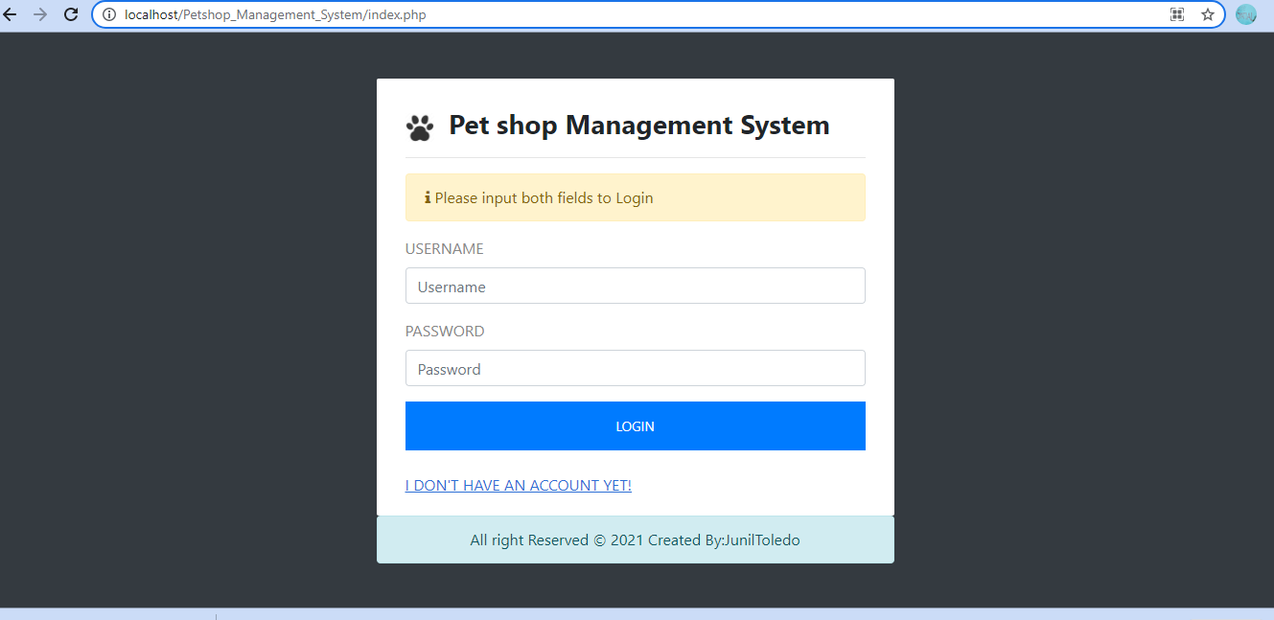
USER INTERFACE DESIGN AND REPORTS

Slide 33
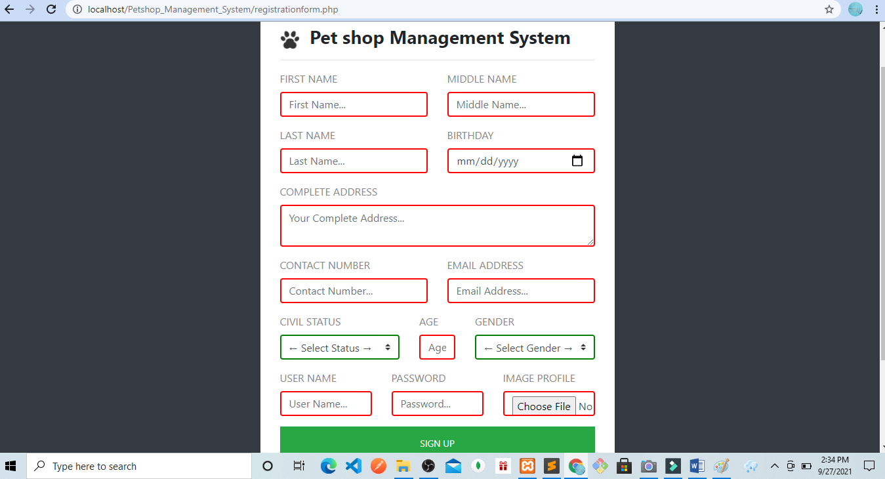

Slide 34
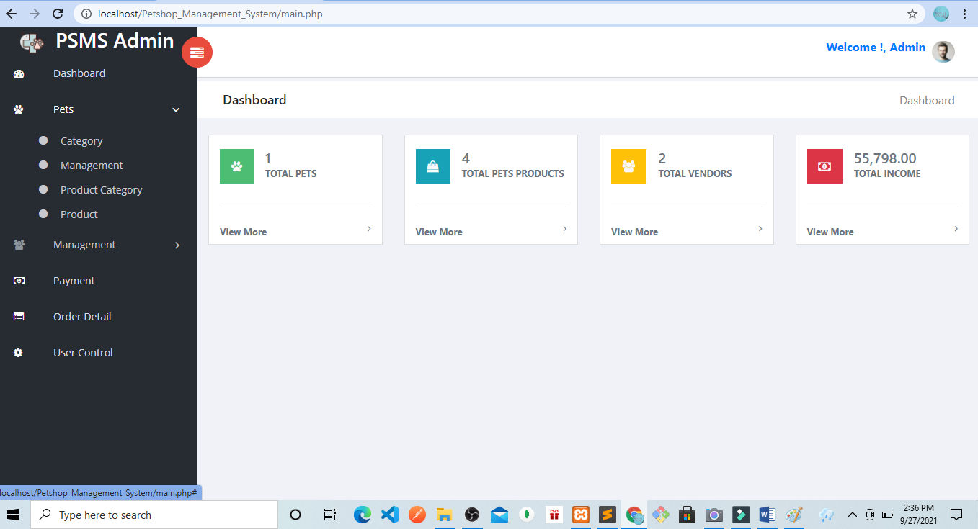

Slide 35
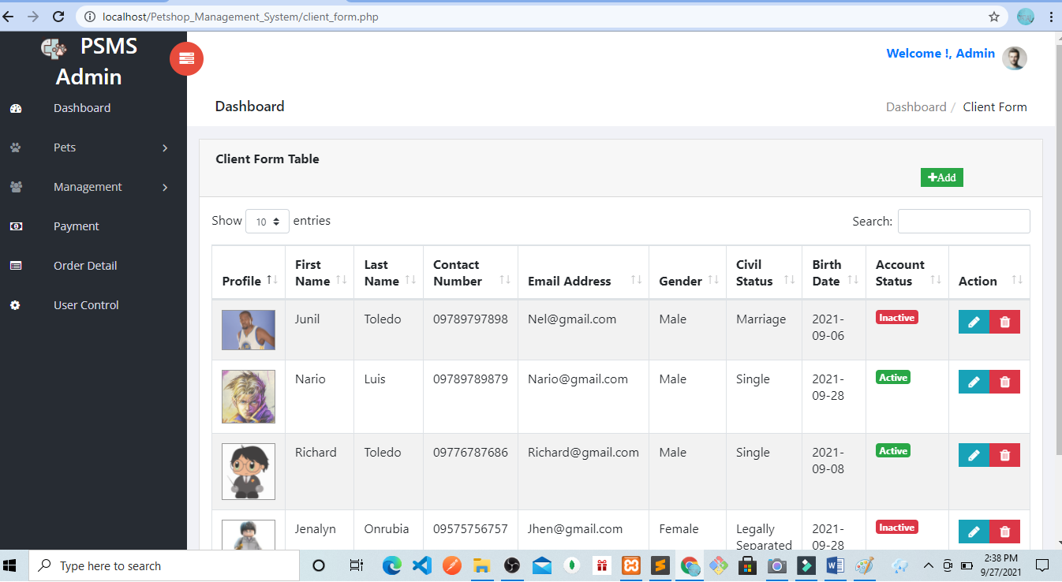

Slide 36
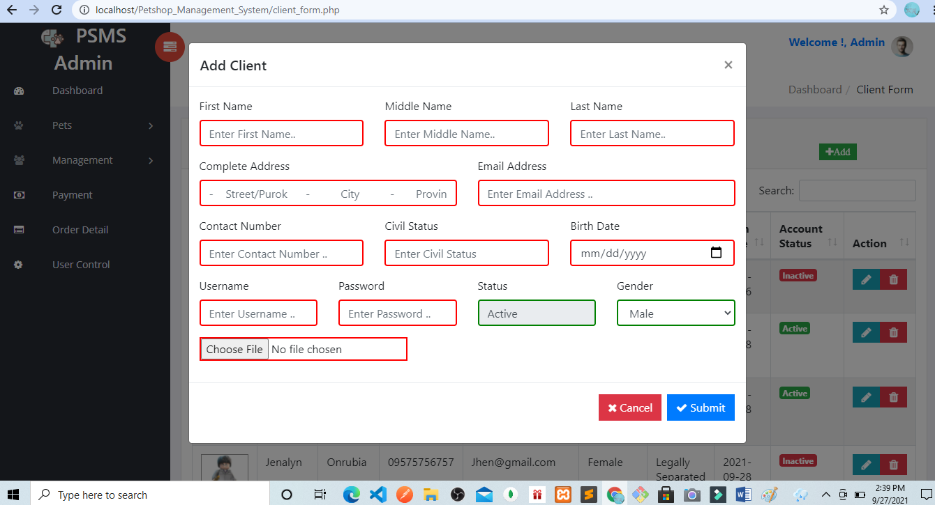

Slide 37
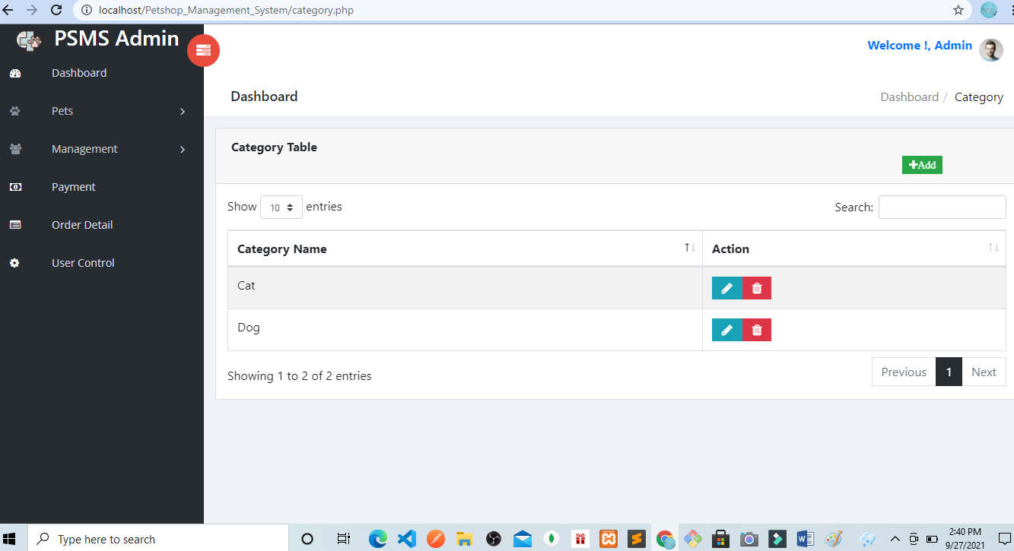

Slide 38
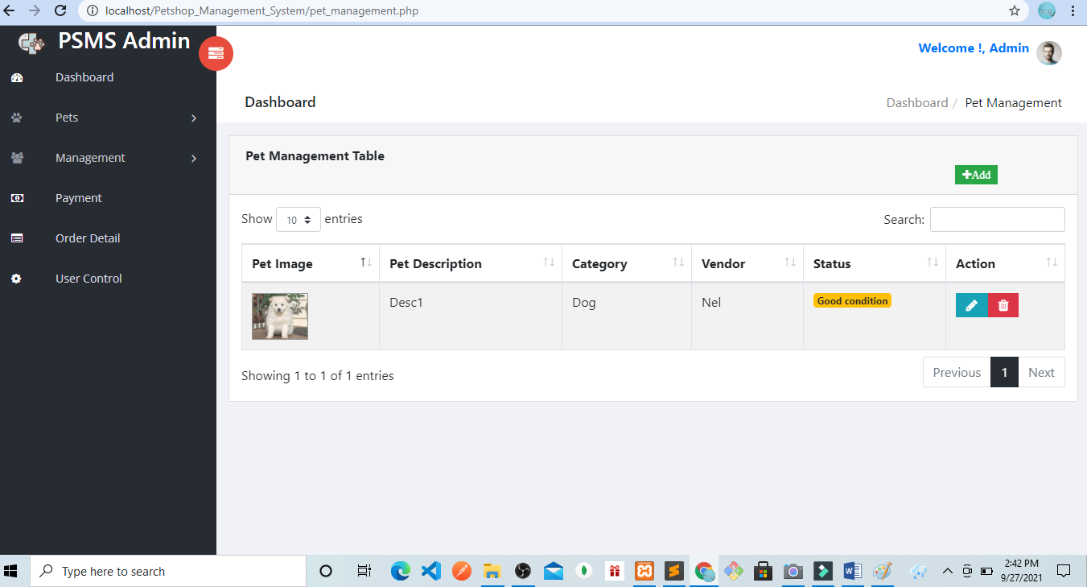

Slide 39
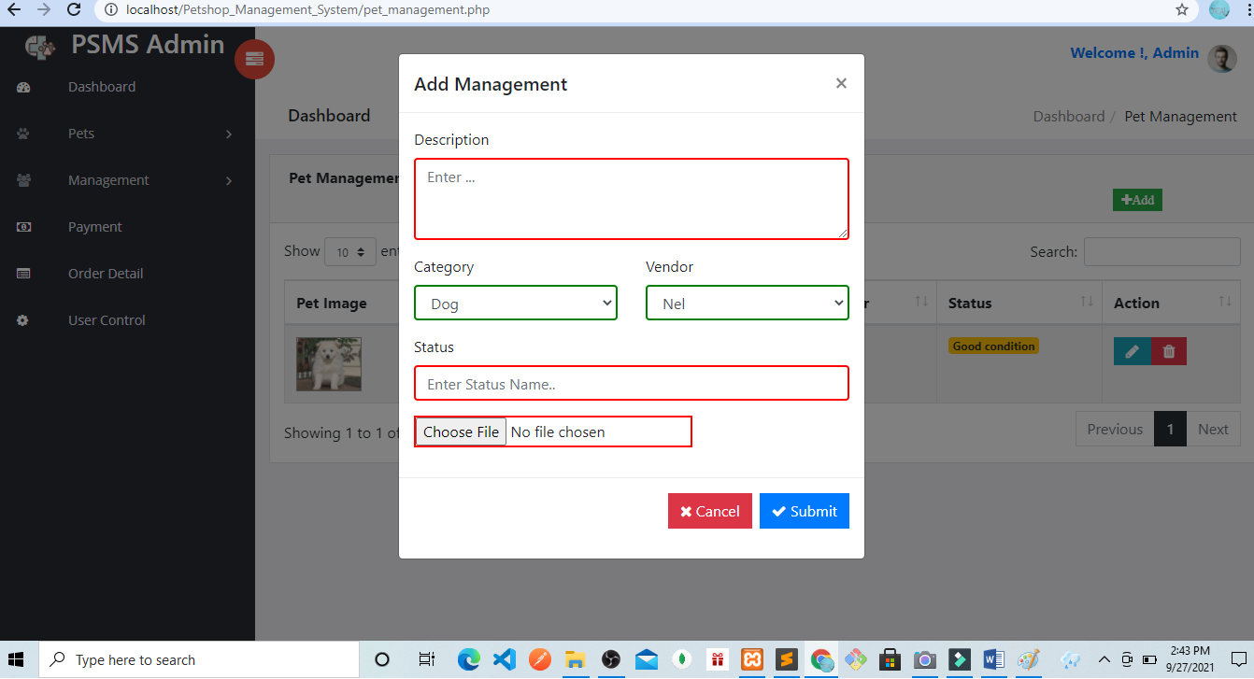

Slide 40
